Slide 1

Exploratory Data Analysis
Bank Marketing Campaign
14th April 2023

Slide 2
Group Name: One
Name: Hira Fahim
Email: hirashahidd26@yahoo.com
Country: United Kingdom
Company: Unemployed
Specialization: Data Science
Batch Code: LISUM19
Submission Date: 14th April 2023
Submitted to: Data Glacier

Slide 3
Background – Bank Marketing Campaign
Problem Description:
ABC Bank wants to sell its term deposit product to customers and before launching the product they want to develop a model which help them in understanding whether a particular customer will buy their product or not (based on customer's past interaction with bank or other Financial Institution).
Hira Fahim

Slide 4
Approach
The analysis has been divided into six parts:
Data Understanding
Exploratory Data Analysis
Univariate Analysis
Correlation Analysis
Bivariate Analysis
Proposed Model Technique
Hira Fahim

Slide 5
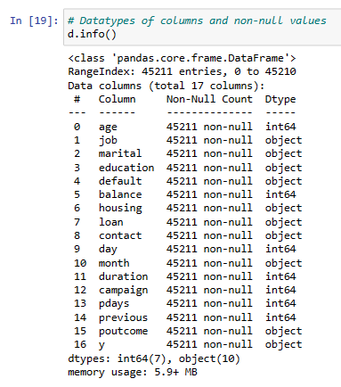
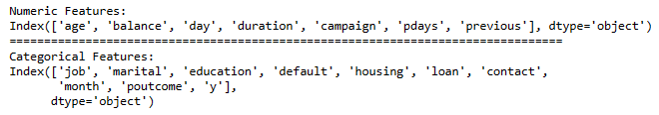
Data Understanding
Dataset Information
The data is related with direct marketing campaigns of a Portuguese banking institution. The marketing campaigns were based on phone calls. Often, more than one contact to the same client was required, to access if the product (bank term deposit) would be ('yes') or not ('no') subscribed.
Datatype of Columns and Non-null values
Numerical and categorical Features
Hira Fahim

Slide 6
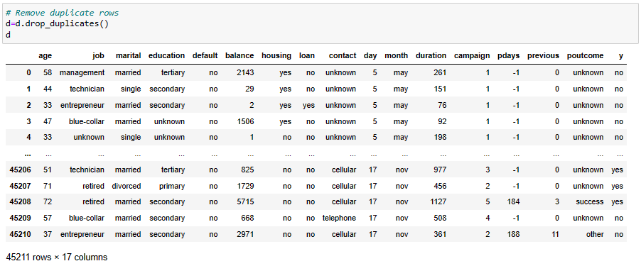
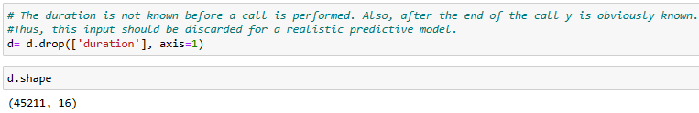
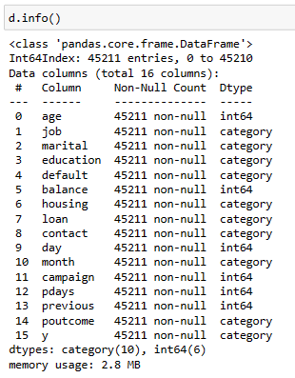
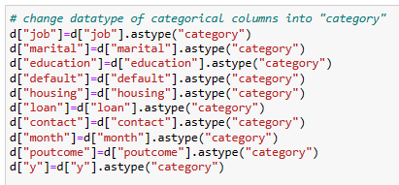
Exploratory Data Analysis
Step:1 Drop Duplicate Rows
Step:2 Drop Unnecessary Column
Final Dataset
Step:3 Change Datatype of Categorical features
Hira Fahim

Slide 7
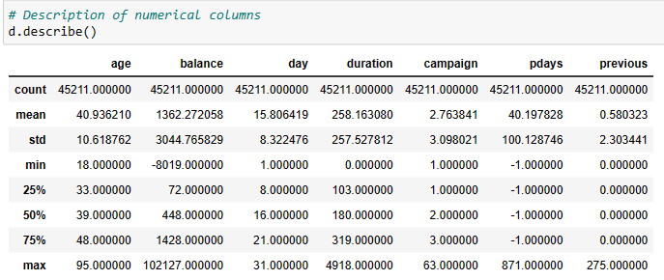
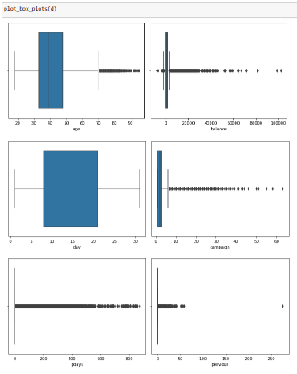
Univariate Analysis
Description of the data
Visualization (boxplot) of Numerical Attributes
From description and boxplot, we can see there are outliers in numerical input variables like age, balance, campaign, pdays and previous. Pdays have most outliers comparatively.
Hira Fahim

Slide 8
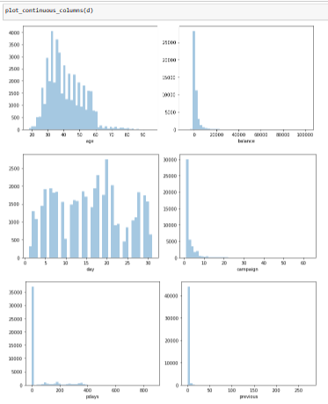
Univariate Analysis
Histogram for Numerical Attributes
In Histogram, we can see input variables like age, balance, campaign, pdays and previous are positively skewed, and we can also see uneven distribution of data in day column.
Hira Fahim

Slide 9
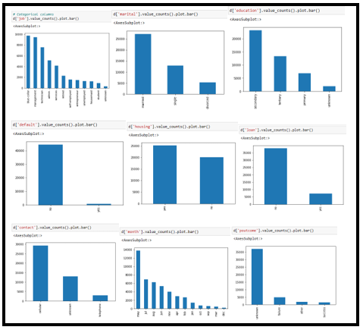
Univariate Analysis
Visualization of Categorical Attributes
In Bar chart of categorical columns, we see uneven distribution of data in all the input categorical columns.
Hira Fahim

Slide 10
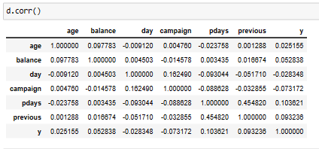
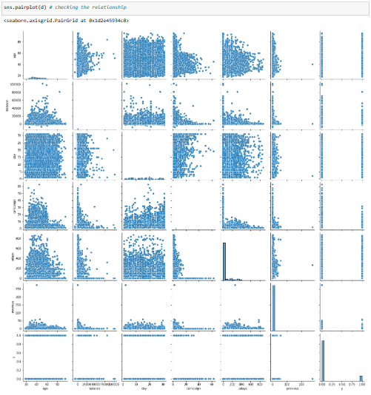
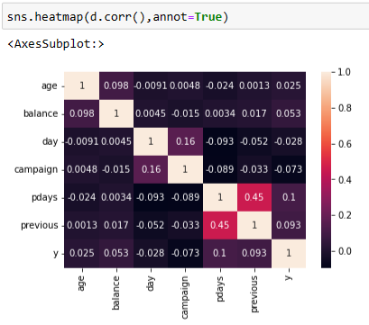
Correlation Analysis
Correlation between numerical input and Output variables
Pairplot
From Correlation Analysis, we see there is less correlation between numerical attribute and output variable
Heat Map
Hira Fahim

Slide 11
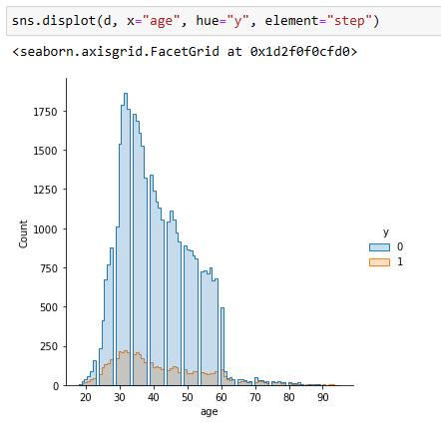
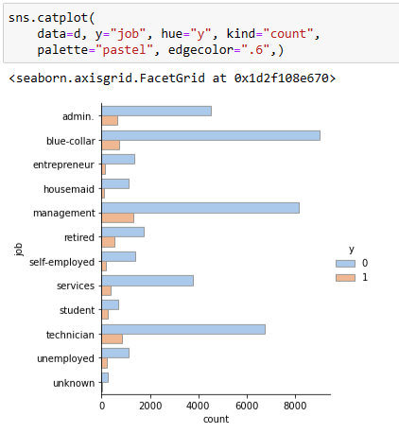
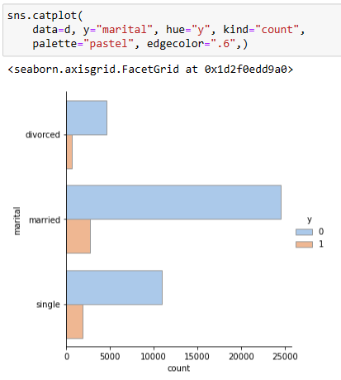
Bivariate Analysis
Term Deposit based on Age
Term Deposit based on Job
Term Deposit based on Marital status
Clients between age 30-40 are more responsive towards term deposit
Clients with job related to 'management, blue-collar and technician' have subscribed for deposit.
Married Clients are main contributor of deposit scheme.
Hira Fahim

Slide 12
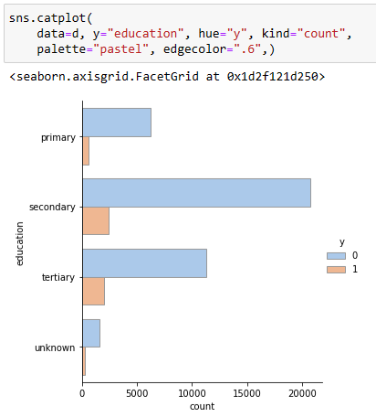
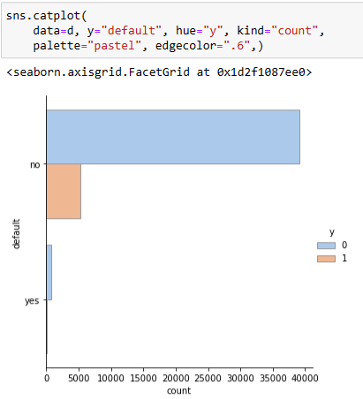
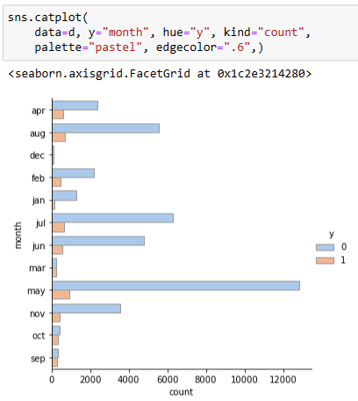
Bivariate Analysis
Term Deposit based on Education
Term Deposit based on Credit default
Term Deposit based on Month
Clients with secondary and tertiary educational background are main contributors.
Clients with good credit history are more interested in term deposit
Investment in term deposit is fluctuating throughout the year but in the month of ‘May’ we have highest success rate.
Hira Fahim

Slide 13
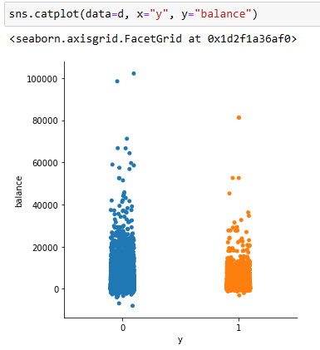
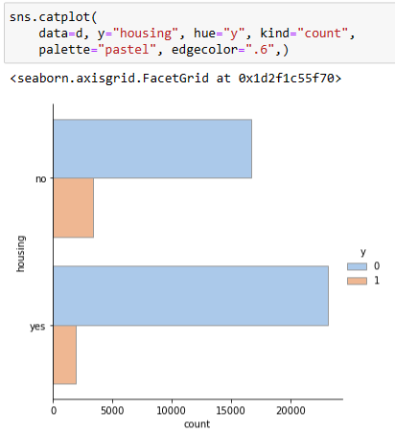
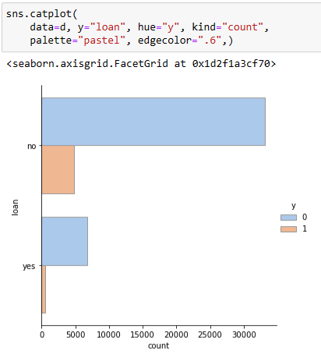
Bivariate Analysis
Term Deposit based on Balance
Term Deposit based on Housing Loan
Term Deposit based on Personal Loan
Client with balance up to 20,000 are more interested in term deposit
Client with no housing loan have subscribed for the term deposit
Client with no personal loan are more interested in term deposit.
Hira Fahim

Slide 14
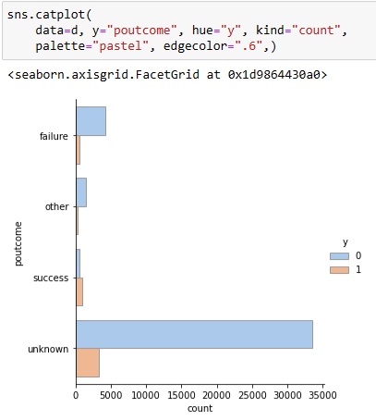
Bivariate Analysis
Term Deposit based on Outcome of Previous Campaign
From the Outcome of previous Campaign, if the outcome is Failure, then there is a less chance that client will subscribe to the term deposit. whereas if the outcome of previous Campaign is Success, then it is more likely that Client will subscribe to the term deposit.
Hira Fahim

Slide 15
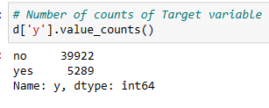
Proposed Modelling Technique
In this section, we choose the type of machine learning prediction that is suitable to our problem. We want to determine if this is a regression problem or a classification problem. In this project, we want to predict weather the clients will subscribe for term deposit or not. The output variable we want to predict is a discrete value; it can be yes(1) or no (0). This can be seen by looking at the target variable in our dataset “y”:
That means that the prediction type that is appropriate to our problem is classification.
Now we move to choose the modelling techniques we want to use. There are a lot of techniques available for classification problems like Logistic Regression, Decision Tree , Random Forest ,SVC, etc.
Hira Fahim

Slide 16
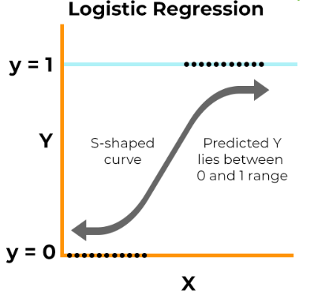
Proposed Modelling Technique
In this project, we will test many modelling techniques, and then choose the technique(s) that yield the best results. The techniques that we will try are:
1. Logistic Regression
Logistic regression is a statistical method that is used for building machine learning models where the dependent variable is dichotomous: i.e. binary. Logistic regression is used to describe data and the relationship between one dependent variable and one or more independent variables.
Hira Fahim

Slide 17
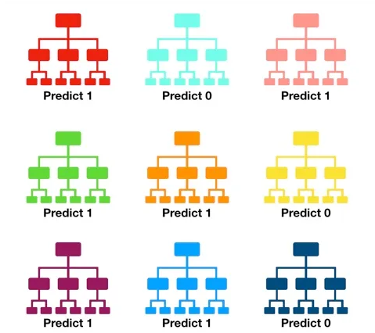
Proposed Modelling Technique
2. Random Forest Classifier
Random forest consists of a large number of individual decision trees that operate as an ensemble. Each individual tree in the random forest spits out a class prediction and the class with the most votes becomes our model’s prediction. It uses averaging to improve the predictive accuracy and control over-fitting.
Tally: Six 1s and three 0s
Prediction: 1
Hira Fahim

Slide 18
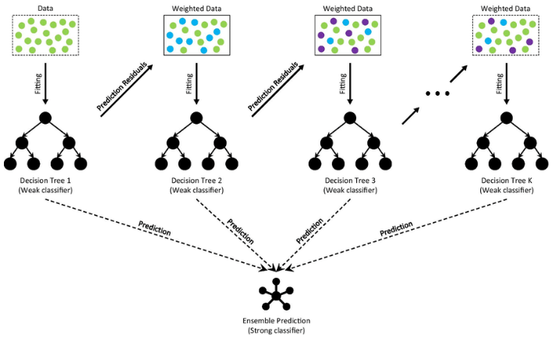
Proposed Modelling Technique
3. Gradient Boosting Classifier
Gradient boosting classifiers are a group of machine learning algorithms that combine many weak learning models together to create a strong predictive model. Decision trees are usually used when doing gradient boosting.
Hira Fahim

Slide 19
Proposed Modelling Technique
Gradient Boosting consists of three essential parts:
Loss Function
The loss function's purpose is to calculate how well the model predicts, given the available data. Depending on the particular issue at hand, this may change.
Weak Learner
A weak learner classifies the data, but it makes a lot of mistakes in doing so. Usually, these are decision trees.
Additive Model
This is how the trees are added incrementally, iteratively, and sequentially. You should be getting closer to your final model with each iteration.
Hira Fahim

Slide 20
Thank You
Hira Fahim

